Slide 1
Filing Status
Married, Single, and More
Pub 4012 – Tab B
Pub 4491 – Part 2 – Lesson
Notes:
#24 – Open TS issue
#30 – Open TS issue

Slide 2

Filing Status
Pub 17 Ch 2
Two criteria:
  Marital status on last day of tax year
    Federal definition – “married”
      Legal marriage under laws of any state or country
      Does not include civil unions or registered domestic partners
  Persons living in the home (may or may not be dependents)
Notes:
2
U.S. state includes the district of Columbia and U.S. territories
Dependent: An individual who may be claimed as a dependent on another person’s tax return; that is, someone who meets all applicable dependency tests.
Will discuss dependents in a later lesson
There is no requirement for taxpayers to substantiate their marriage – their statement that they are married is enough

Slide 3
Five Choices for Filing Status
Pub 4012 Tab B
Single
Married filing jointly (MFJ)
Married filing separately (MFS)
Head of household (HoH)
Qualified widow(er) (QW)
Notes:
Dependent: An individual who may be claimed as a dependent on another person’s tax return; that is, someone who meets all applicable dependency tests.
Head of Household Filing Status: This filing status is generally for unmarried taxpayers who paid more than half the cost of keeping up a home for a qualified dependent relative during the tax year.
Married Filing Jointly: Filing status for taxpayers who are married to each other or live together in a common law marriage and combine their income and deductions on the same tax return. The status also applies to taxpayers who are separated but not divorced and to taxpayers whose spouse died during the tax year and has not remarried, as long as one tax return is used for both individuals.
Married Filing Separately: Filing status for taxpayers who are married to each other or live together in a common law marriage and report their own incomes and deductions on separate returns.
Qualifying Widow(er) with Dependent Child: Filing status is for widow or widower with one or more dependent children.
Single Filing Status: Filing status that applies to a taxpayer who (1) has never married, or (2) is legally separated or divorced.

Slide 4
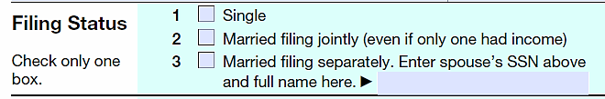
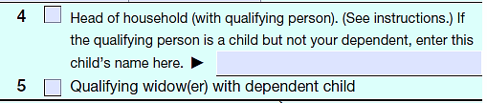
Form 1040

Slide 5
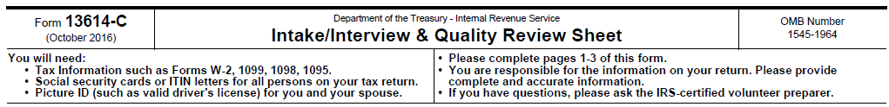
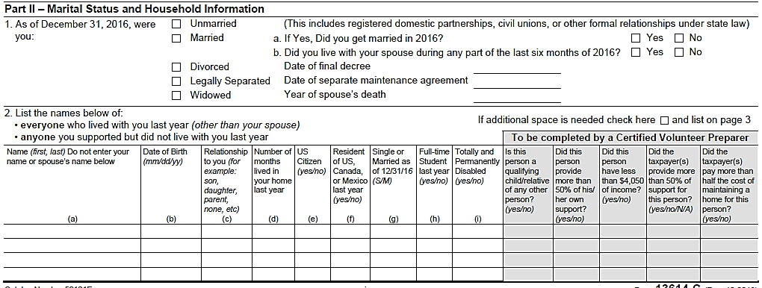
Intake/Interview Sheet
Check Part II entries on Intake Sheet
Ask questions – verify

Slide 6
Living Situation Analysis
Marital status as of 12/31
Others living in home or supported by taxpayer, if any
  Their relationship/dependency
  Paid >50% of upkeep of the home?
If widow(er)
  Date of death of spouse
  Any dependent children at home

Slide 7
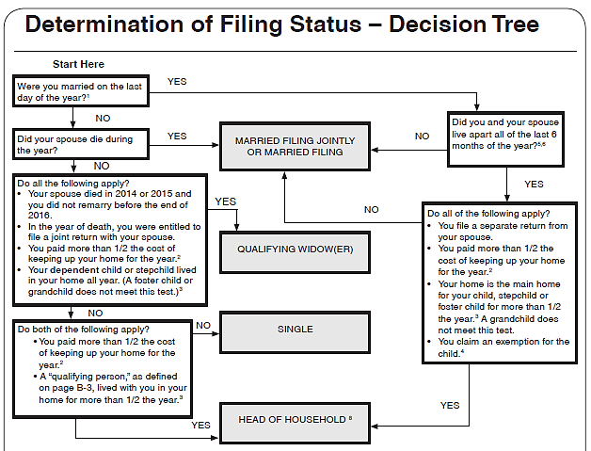
Use the Decision Tree
Open
Pub 4012
To Page B-1
Don’t miss
the
footnotes
Notes:
Direct student to open Pub 4012 to Page B-1 and then lead the discussion
Don’t miss the footnotes

Slide 8
Filing Status Importance
Many tax items affected by filing status
  Necessity to file a return (Pub 4012 Page A-1 Chart A)
  Standard deduction (Pub 4012 Page F-1 Exhibit 1)
  Tax rate bracket
  Eligibility for certain credits (Pub 4012 Page I-3 Step 3)
Notes:
8

Slide 9
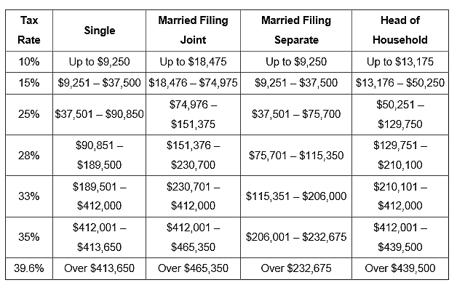
Filing Status – Tax Rate

Slide 10
Single
Not married as of December 31st
Married, but legally separated
May be a more advantageous filing status if:
  Recently widowed
  Have qualifying persons in the home
  Paying >50% of the home’s upkeep
  See Qualifying Widow(er) or Head of Household

Slide 11
Married Filing Jointly
Married on last day of year
Common law marriage
  If recognized in state where started
Spouse died during current year/not remarried
Generally, most advantageous filing status
Notes:
One return combining income and deductions of both spouses
On last day of year:
Married and live together
Live apart but not legally separated or divorced
Live together in recognized common law marriage
Separated but divorce decree not final
Spouse died during year/not remarried

Slide 12
Married Filing Separately
Taxpayer chooses to file MFS
Spouse has already filed MFS
Married but separated and not filing MFJ
Rare cases – more advantageous
  Generally, no children in home

Slide 13
MFS Disadvantages
Highest tax rate/lower standard deduction
Cannot claim most tax credits
Cannot deduct student loan interest
Capital loss limit $1,500 (not $3,000)‏
Notes:
MFS – Lived With Spouse Anytime During The Year
Cannot claim credit for the elderly or the disabled, cannot claim education credits, EIC
Must include social security benefits as income (up to 85% can be taxable)‏, unless lived apart the whole year

Slide 14
Injured Spouse
A common reason taxpayers choose MFS is to avoid an offset of their refund against their spouse’s outstanding debts such as:
  Past due child support
  Past due student loans
  Tax liabilities
In this case filing MFJ with Form 8379 Injured Spouse Allocation is an alternative

Slide 15
Injured Spouse Requirements
Filing MFJ and only one spouse owes past due amounts
The other spouse can be considered the Injured Spouse and
  Must NOT be legally obligated to pay those debts
  Must have made and reported tax payments (such as withholding) or claimed a refundable tax credit

Slide 16
Form 8379
Injured Spouse Allocation
Form 8379 can be filed by itself if the joint return has been filed and the refund was offset
Include copies of all forms for both spouses that show income tax withheld

Slide 17
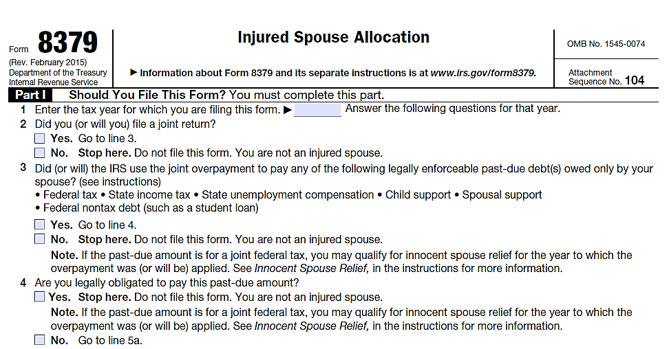
IRS Form 8379 (partial view)

Slide 18
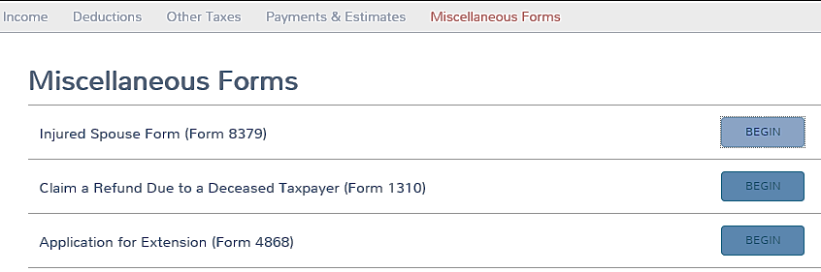
TaxSlayer Injured Spouse

Slide 19
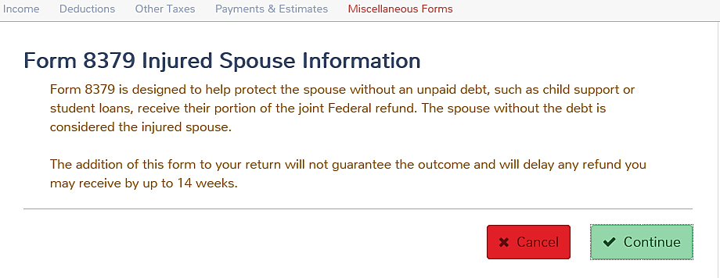
TaxSlayer Injured Spouse (con’t)

Slide 20
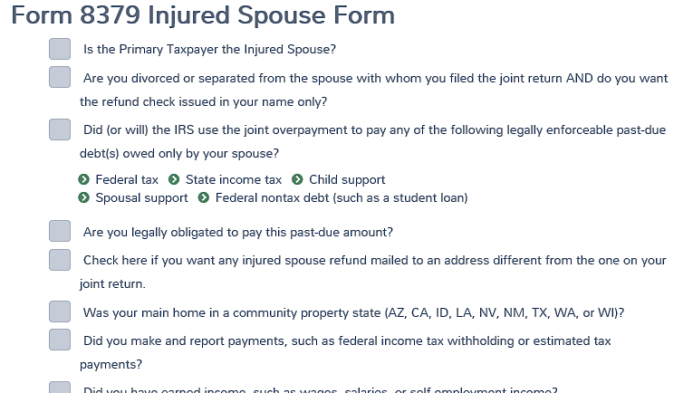
TaxSlayer Form 8379 Input
Notes:
Injured spouse may be out of scope in community property states

Slide 21
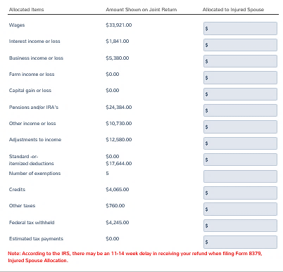
TaxSlayer Form 8379 Input
The counselor must thoroughly review the injured spouse’s tax documents to allocate the proper amount of income, and taxes withheld and check which credits/adjustments should be allocated to the injured spouse. Do not allocate EIC, the IRS will determine that allocation.

Slide 22
Head of Household – Unmarried
Provided home* for qualified child
  Might not be a dependent
Provided home* for related dependent
>50% cost of maintaining home for dependent parents living elsewhere
* Paid more than 50% of cost of keeping up the home
Notes:
The trifold laminate can be helpful in determining head of household filing status.

Slide 23
Head of Household – Married
Lived apart all of last 6 months of year
Provided home* for:
  Child, stepchild, or eligible foster child for over six months
No other relatives qualify
* Paid more than 50% of cost of keeping up the home

Slide 24

Head of Household – Married to Non-Resident Alien
Issue #480
Can live together
Spouse does not elect to be taxed as a resident
Provided home* for: a qualifying person (not spouse)
  * Paid more than 50% of cost of keeping up the home

Slide 25
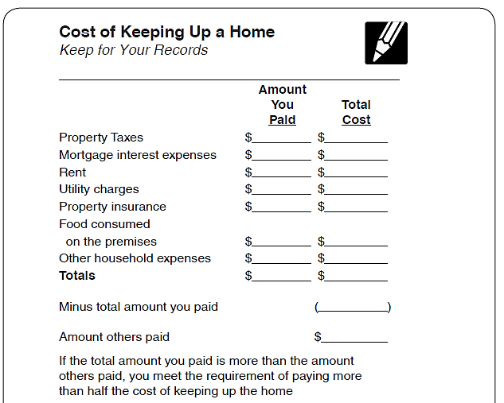
Head of Household – Providing a Home
Open
Pub 4012
To Page B-4

Slide 26
Head of Household
Key advantages
  Higher standard deduction than Single or MFS
  Advantageous tax rate structure

Slide 27
Qualifying Widow(er)
Spouse died in one of two past years
  Dependent child and/or stepchild lived in home All year
  Grandchild not eligible
Maintained >50% of cost home for child
Can file QW for two years only
Advantages
  Standard Deduction – same as MFJ
  Uses MFJ tax rates

Slide 28
Special Notes
Child is considered to have lived with taxpayer all year if born or died during year (but not stillborn)
Child who is dependent of non-custodial parent under Rules for Divorced or Legally Separated Parents still qualifies custodial parent for HoH filing status if all other requirements met

Slide 29

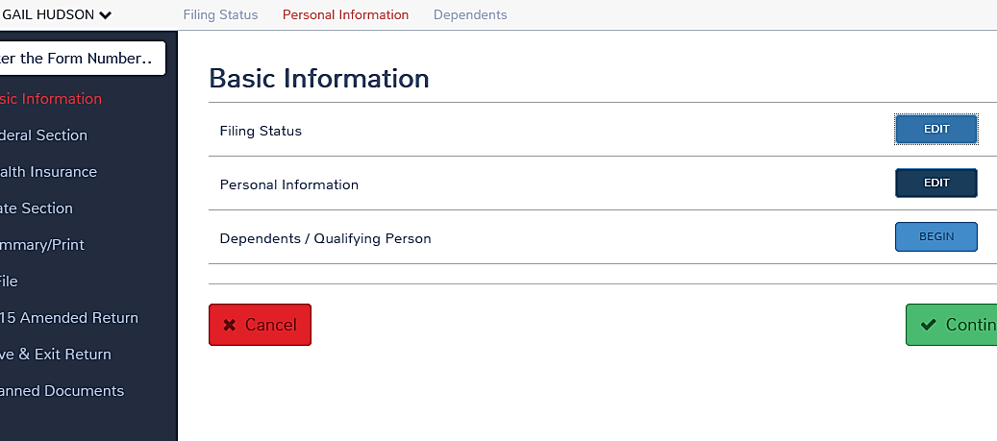
TaxSlayer– Basic Information

Slide 30
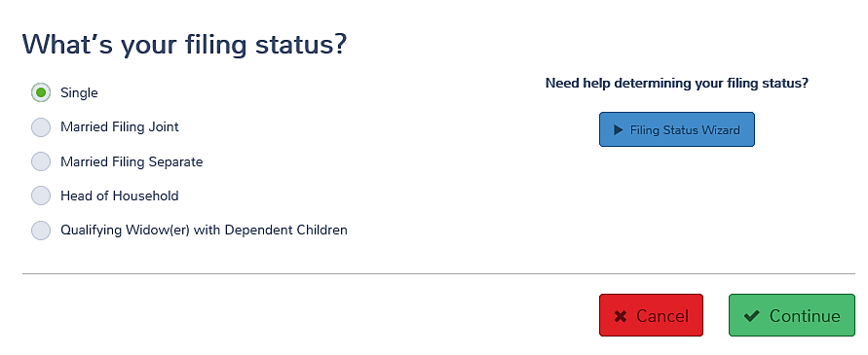
TaxSlayer– Filing Status
Caution: changing the status will delete the state return, if any.
Issue #515

Slide 31
Quality Review
Review is more than just checking that a box is checked ask probing questions
Review prior year’s status
Verify current year filing status with data on Intake Sheet
Is this the correct and most advantageous filing status for the taxpayer?

Slide 32
Problem #1
Mr. Buck provides total support for his two young children. His wife died in 2013, and he has not remarried.
What is the best filing status for Mr. Buck?
Head of Household
What would have been best if his wife died in TY2014?
Qualifying Widower

Slide 33
Problem #2
Jane, 69, whose husband died July 1 last year, had a $20,000 pension and $15,000 in social security in the tax year.
Her 10-year-old grandson lived with her and is her dependent.
What is the best filing status for Jane?
MFJ
Assuming nothing changes, what filing status is best for next year?
Head Of Household

Slide 34
Problem #2 (cont)
Note:
Grandchild is not a qualifying child dependent for Qualifying Widow(er) with Dependent Child purposes – own child or stepchild only

Slide 35
Problem #3
Luke and Linda are still married, but chose to live apart for most of the year
Their two children lived with Linda all year
In July, Luke was out of a job so he moved back in the house for just that month
What filing status can they each choose?
MFJ or MFS (both must use same status)

Slide 36
Problem #4
Peter is single
Peter’s mother lived with him until March last year.
In March Peter moved his mother to a nursing home and he pays for her room and care
What is Peter’s best filing status?
Head of Household

Slide 37
Problem #5
Jack and Jill Murphy are married and want to file MFS because Jack owes back child support and their refund will be offset
What other options do they have?
What probing questions do you ask?

Slide 38
Problem #5 (Con’t)
They can file MFJ with Form 8379 Injured Spouse Allocation
Probing questions:
  Is Jill legally obligated to pay any of the debts?
  Did Jill make and report tax payments (such as withholding) or claim a refundable tax credit?

Slide 39

Filing Status
Questions?
Comments?

